Slide 1
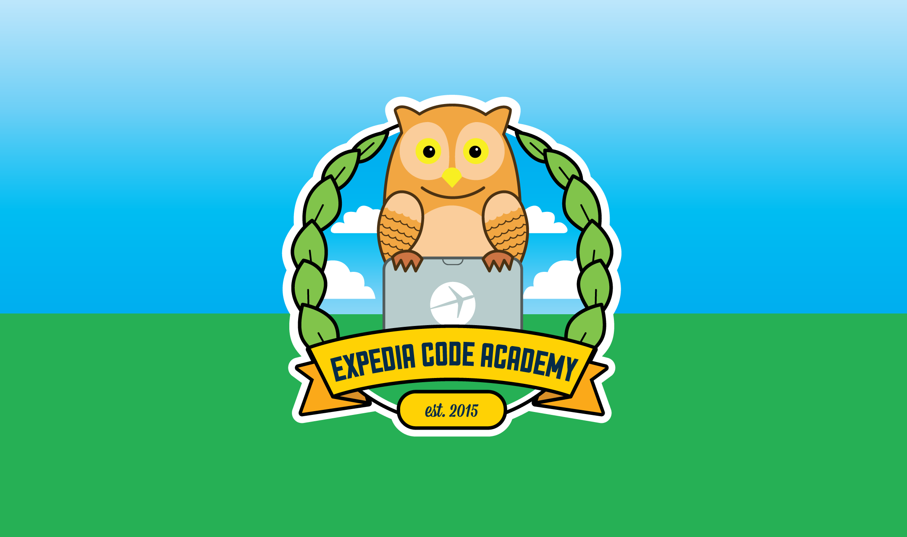
Python Level 2
882.33
Lesson 4: Getting to know JSON

Slide 2
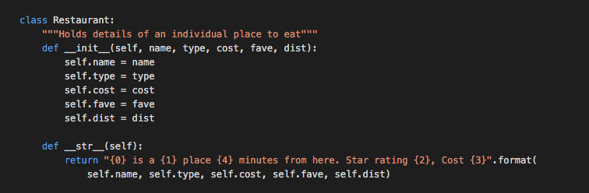

Last week

Slide 3
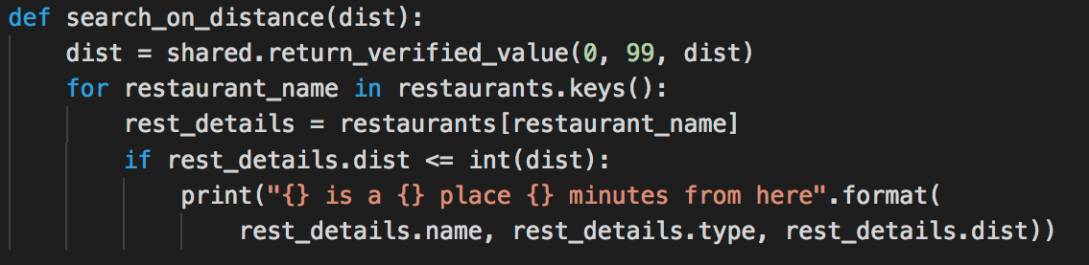
Last week (continued)

Slide 4
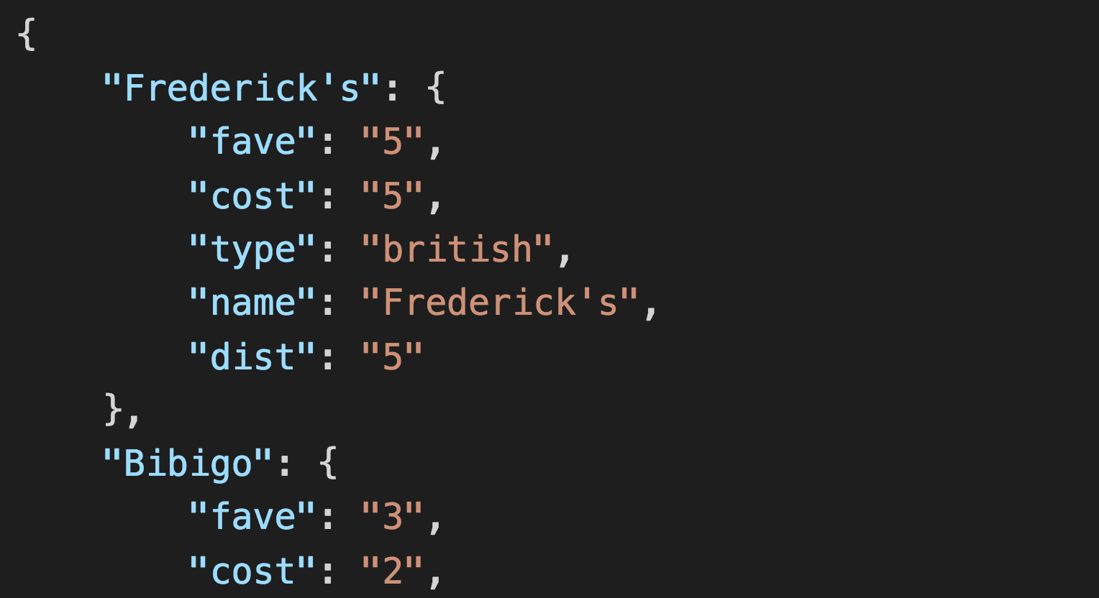
And now for something completely different…
What is this?

Slide 5
JSON: JavaScript Object Notation
Common form of data encoding
Allows us to create more complex data structures than CSV
Uses similar data structures to Python:
Strings
Integers and floats
Lists
Dictionaries
Let’s all start with the same base code:
http://eca-python/l2session4

Slide 6
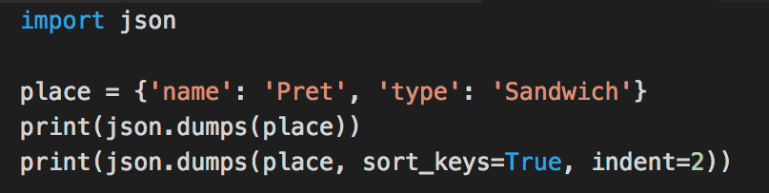
Getting to know JSON

Slide 7
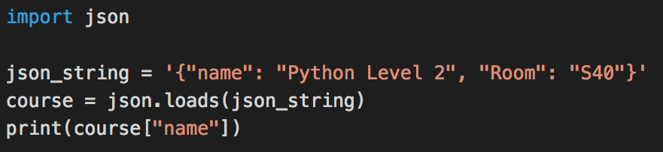
Getting to know JSON a bit better

Slide 8
…But wait, what?
We can save or print a dictionary as a JSON object.
We can convert a string containing a JSON dictionary into a Python one.
What happens if we try to dump details of a Restaurant? Try it!
Here’s one I made earlier:

Slide 9

…But wait, what?
We can save or print a dictionary as a JSON object.
But not an arbitrary class (like Restaurant)
Let’s add a method to class Restaurant to convert it to a dictionary:

Slide 10
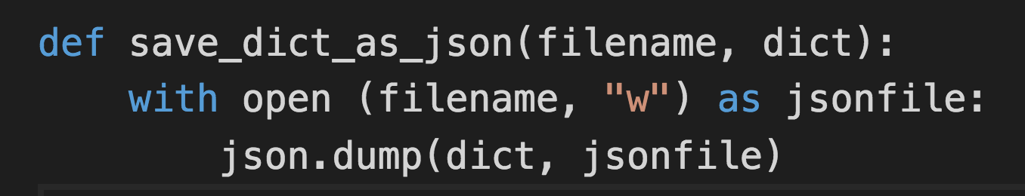
Interacting with files

Slide 11
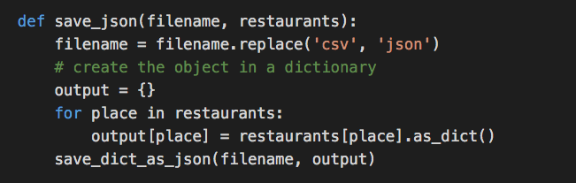
Now we can save as JSON or CSV

Slide 12
Exercise/Homework…
Make changes to your program so that it will load and save either
JSON
CSV
pydoc json may well give you a hint here
Next week we’ll be using JSON in an different way.

